Slide 1

UI & Forms
Trainer markova.milica@gmail.com
Assistant ristopavlov@gmail.com

Slide 2
Agenda
ASP.NET MVC
UI and Forms
Creating Views Manually
Using DataBinding and HtmlHelpers
Scaffolding and View Templates
ModelState
Model Validation Attributes
Code academy @ Skopje, 2018-2019

Slide 3
Creating Views Manually
ASP.NET MVC
Views Can be added manually into Views Folder
NOTE:
The action name should correspond with the view name. ActionName Attribute can be used to change the name of the action if it's needed
Code academy @ Skopje, 2018-2019

Slide 4
Using Data Binding And HtmlHelpers
ASP.NET MVC
Data Binding is done by Using the '@' character
Html Helpers can be used to easily create html content such as links, input fields, dropdowns, labels and forms
You can further complicate your life by creating custom HtmlHelpers
Code academy @ Skopje, 2018-2019

Slide 5

Data Binding Example
ASP.NET MVC
Code academy @ Skopje, 2018-2019

Slide 6
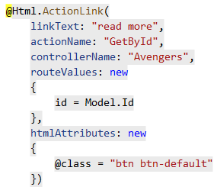
Html Helpers Example
ASP.NET MVC
Code academy @ Skopje, 2018-2019

Slide 7
Scaffolding and View Templates
ASP.NET MVC
Tired of creating views?
Scaffolding is a code generation technique used by many web application frameworks like ASP.NET MVC, Ruby on Rails, Cake PHP, Node.JS and many more
Visual studio provides several scaffolding templates for generating views for basic CRUD operations
Code academy @ Skopje, 2018-2019

Slide 8
ModelState
ASP.NET MVC
Property of the controller
Collection of name and value pairs that were submitted to the server
Contains a collection of error messages for each value submitted
Has some helpful properties like IsValid which indicates whether there are any validation errors
Code academy @ Skopje, 2018-2019

Slide 9
Model Validation Attributes
ASP.NET MVC
To tell the framework how and which data to validate we should decorate the model with some validation Attributes
A short List of Validation Attributes:
Required
StringLength
MinLength/MaxLength
Range
RegularExpression
Code academy @ Skopje, 2018-2019

Slide 10
?
ASP.NET MVC
Code academy @ Skopje, 2018-2019

